Slide 1
Reproduction in bacteria

Slide 2
Types of Reproduction in bacteria
Asexual Reproduction
A type of reproduction in which only one bacterial cell will produce nascent progeny cells.
Mitosis is involved.
Binary fission: Single parent cell doubles its DNA, then divides into two cells. Usually occurs in bacteria.
A cell just needs to grow to twice its starting size and then split in two.
A bacterium must divide at the right time, in the right place, and must provide each offspring with a complete copy of its essential genetic.

Slide 5
Endospore formation in bacteria
Microorganisms sense and adapt to changes in their environment
This complex developmental process is often initiated in response to nutrient deprivation.
It allows the bacterium to produce a dormant and highly resistant cell to preserve the cell's genetic material in times of extreme stress.
Endospores can survive environmental assaults that would normally kill the bacterium

Slide 6
These stresses include high temperature, high UV irradiation, desiccation, chemical damage and enzymatic destruction
The extraordinary resistance properties of endospores make them of particular importance because they are not readily killed by many antimicrobial treatments.
A variety of different microorganisms form "spores" or "cysts", but the endospores of low Gram-positive bacteria are by far the most resistant to harsh conditions.

Slide 7
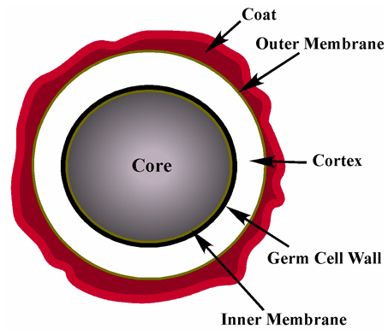
Bacterial Endospore

Slide 8
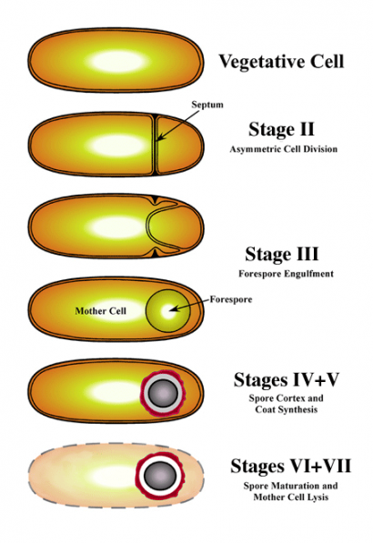

Slide 9
Sexual Reproduction in Bacteria
Basically in bacteria there is no differentiation of sexes only strains are considered different.
In sexual reproduction of bacteria two cells/ entities are involved between which the genomic exchange takes place.
Conjugation
Transformation
Transduction

Slide 10
Conjugation
Transfer of genetic material between bacterial cells by direct cell-to-cell contact or by a bridge-like connection between two cells. This takes place through a pilus.
The donor (f+) cell provides a conjugative or mobilizable genetic element that is most often a plasmid to the recipient(f-) bacterial cell.

Slide 11
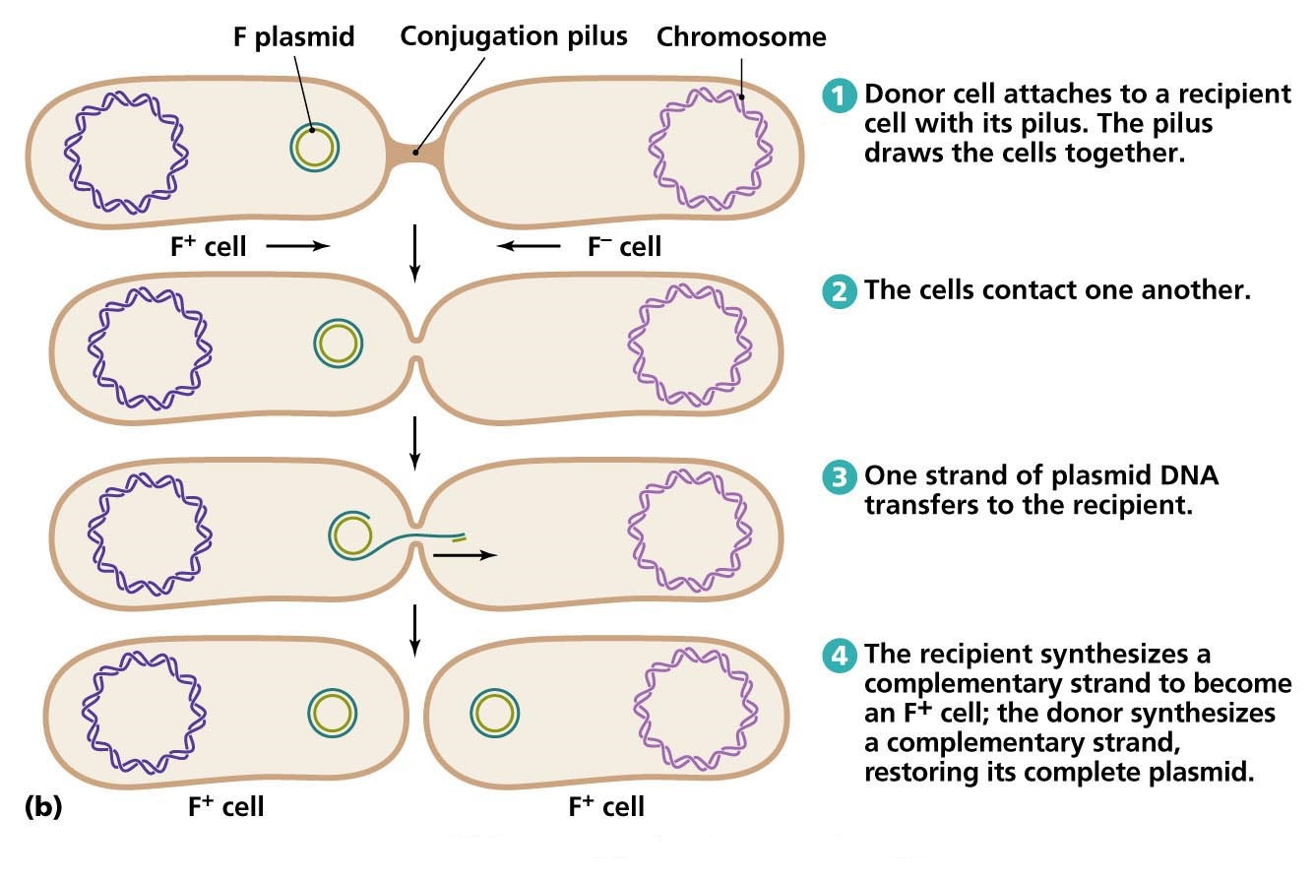

Slide 12
Transformation
Bacterial transformation is a process of horizontal gene transfer by which some bacteria take up foreign genetic material (naked DNA) from the environment. It was first reported in Streptococcus pneumoniae by Griffith in 1928. DNA as the transforming principle was demonstrated by Avery et al in 1944.

Slide 13
The process of gene transfer by transformation does not require a living donor cell but only requires the presence of persistent DNA in the environment. The prerequisite for bacteria to undergo transformation is its ability to take up free, extracellular genetic material. Such bacteria are termed as competent cells.

Slide 14
The factors that regulate natural competence vary between various genera. Once the transforming factor (DNA) enters the cytoplasm, it may be degraded by nucleases if it is different from the bacterial DNA. If the exogenous genetic material is similar to bacterial DNA, it may integrate into the chromosome. Sometimes the exogenous genetic material may co-exist as a plasmid with chromosomal DNA.

Slide 15
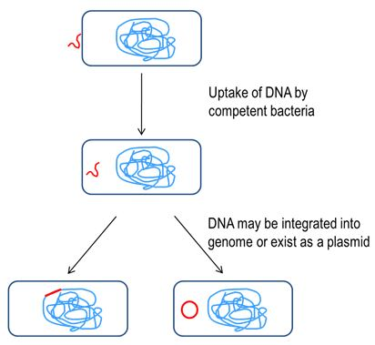

Slide 16
Transduction
The process by which foreign DNA is introduced into a bacterial cell by a virus or viral vector.
An example is the viral transfer of DNA from one bacterium to another and hence an example of horizontal gene transfer.
Transduction does not require physical contact between the cell donating the DNA and the cell receiving the DNA (which occurs in conjugation), and it is Dnase resistant (transformation is susceptible to DNase)

Slide 17
Viruses, including bacteriophages (viruses that infect bacteria), infect bacterial cells, their normal mode of reproduction is to harness the replicational , transcriptional, and translation machinery of the host bacterial cell to make numerous virions, or complete viral particles, including the viral DNA or RNA and the protein coat.

Slide 18
Generalized transduction
Generalized transduction is the process by which any bacterial DNA may be transferred to another bacterium via a bacteriophage.
Specialized transduction
Specialized transduction is the process by which a restricted set of bacterial genes is transferred to another bacterium.

Slide 19
